Slide 1
SCAF WATER POLO
High School Officials Instruction
2025-26
Clinic #2
Rule Book Clarifications
Rules Test Review
Calling the Game
Reminders
Protests
Shallow Water
Q&A
Assigning

Slide 2
Rule Book Clarifications/Corrections
(hopefully fixed these last year)
Go to page 46-47 of the rule book:
cross out 4-22 Art. 5 d. the replacement of a cap or while zipping up a suit.
Go to page 76 of the rule book:
replace in 7-21 (under the NOTE:) “final minute of the game” to read “within the last minute of regulation, last minute of second overtime period, or anytime during sudden death”

Slide 3
NFHS Rules Test Review
If you have not taken the rules test yet please exit the room and have a discussion with your area president on how to proceed.

Slide 4
NFHS Rules Test Review
Reminder that the primary objective of the rules test was to make referees think a little more and to encourage them to interact with the rule book.
Please take out your rule books and your copy of this years test (hopefully your presidents/instructional chairs asked you to print out a copy) as we go through the most missed questions.

Slide 5
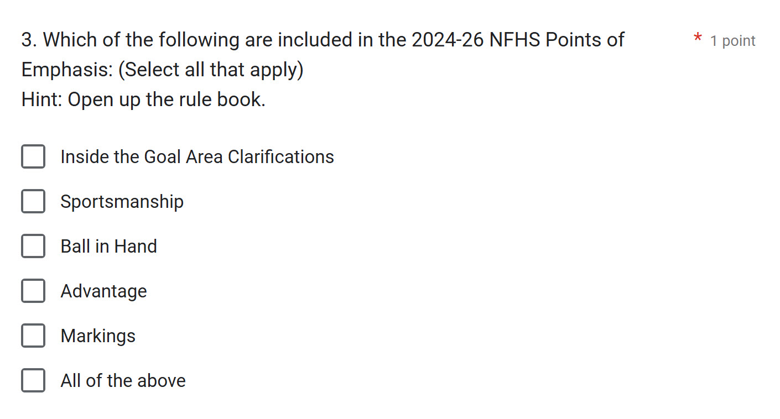
NFHS Rules Test Review
Go through the following questions with the help of your rule book
Most missed questions in order by % missed (as of Saturday, Aug. 9th 10:00 am)
Many chose “All of the above”
This is one where I just wanted you to open up the rule book like the Hint said.

Slide 6
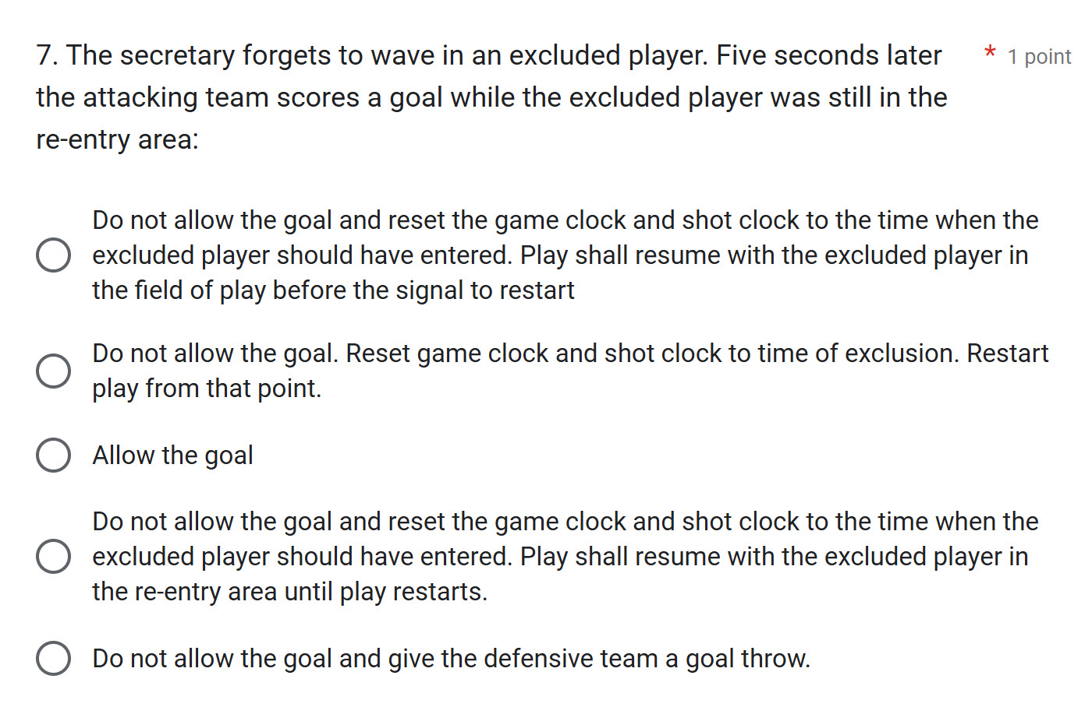
NFHS Rules Test Review
Go through the following questions with the help of your rule book
Many chose the first answer.
Remember, play shall resume with the excluded player in the re-entry area and then waved in once play is restarted.
Pg. 30 - b. (at the bottom)

Slide 7
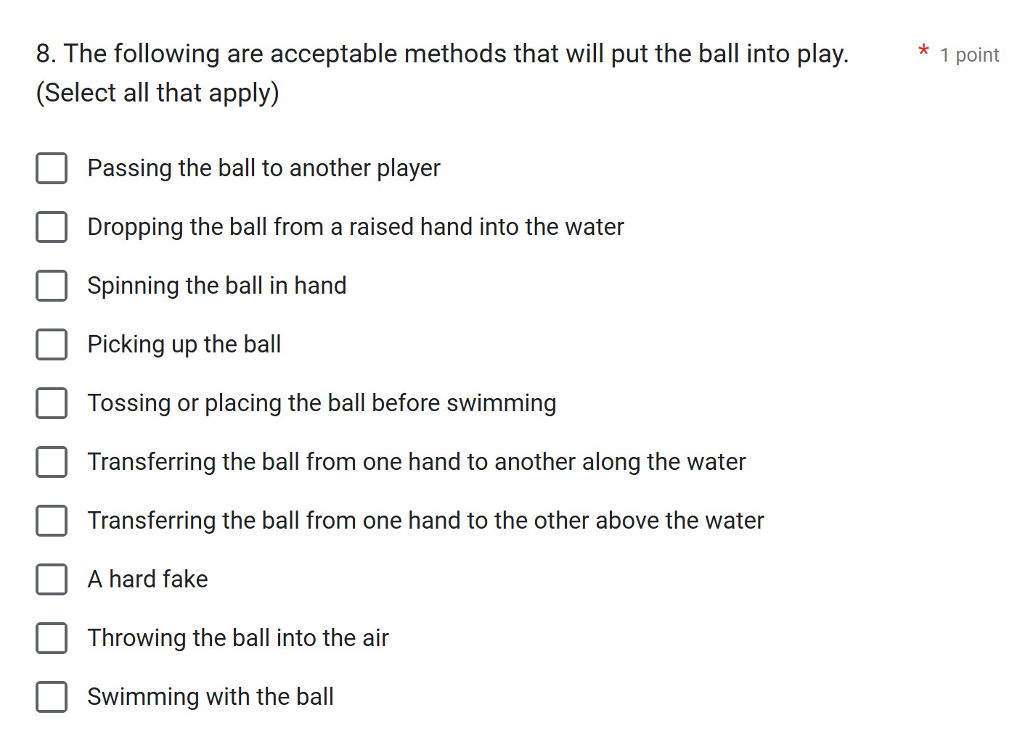
NFHS Rules Test Review
Go through the following questions with the help of your rule book
Many chose the Transferring the ball from one hand to another along the water.
Know all the proper ways of “putting the ball in play”
Pg. 53 - Section 13
Free Throws - How Taken

Slide 8
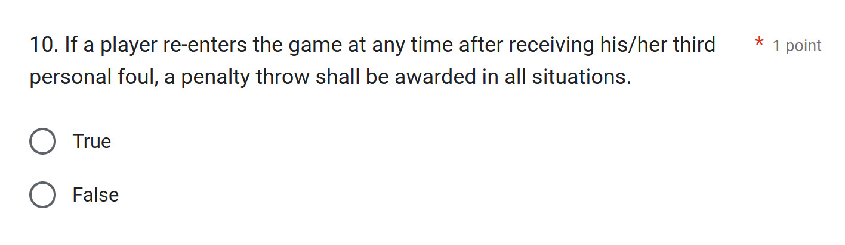
NFHS Rules Test Review
Go through the following questions with the help of your rule book
This was here for you to read through page 18 - 2.1.3 situation C
When a player is not properly red flagged.

Slide 9
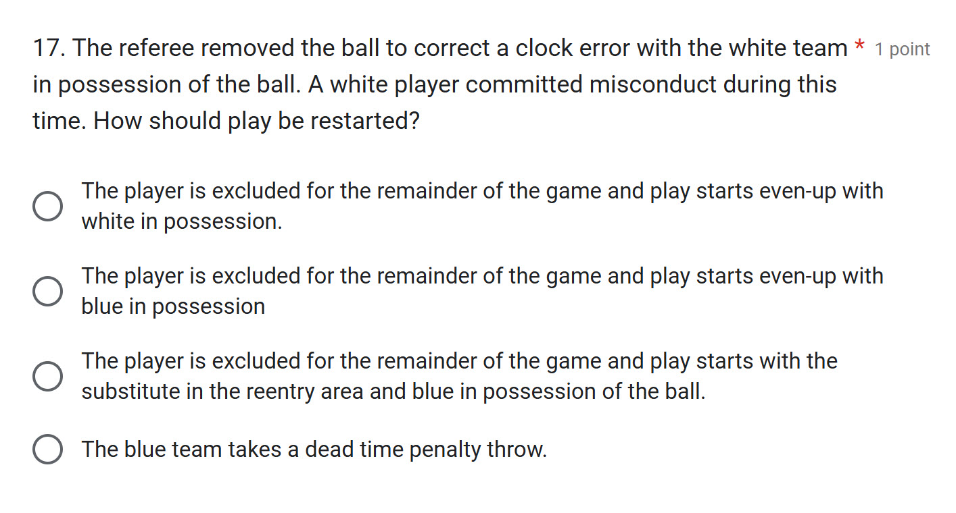
NFHS Rules Test Review
Go through the following questions with the help of your rule book
Reminder that when the ball is removed to correct a clock error, this is considered “Interval Time”
Pg. 44 - Section 14 e.

Slide 10
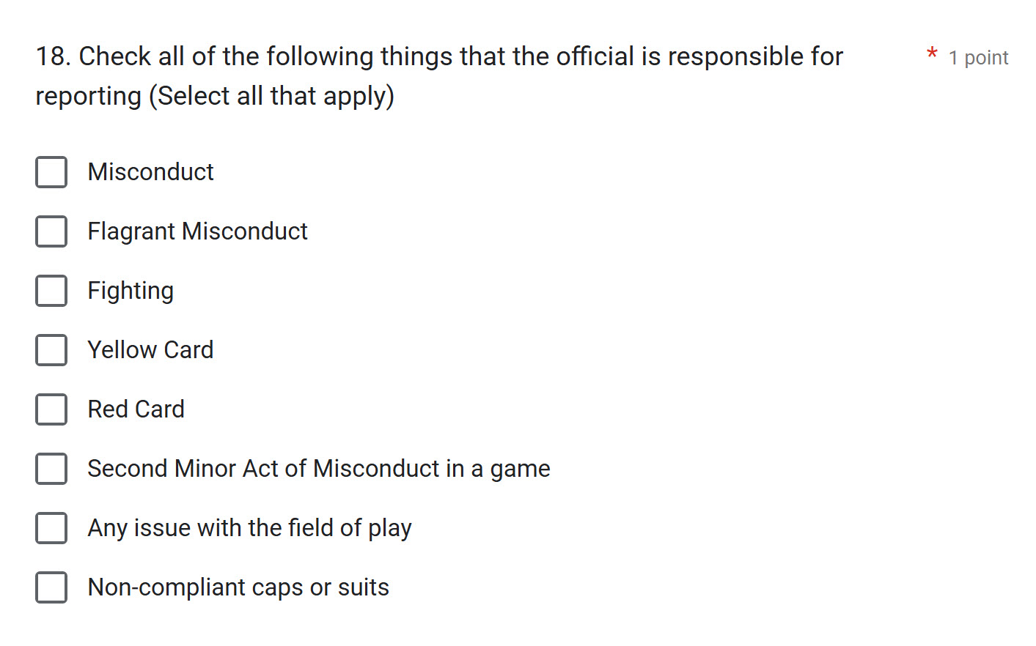
NFHS Rules Test Review
Go through the following questions with the help of your rule book
Yellow Cards are NOT reportable.

Slide 11
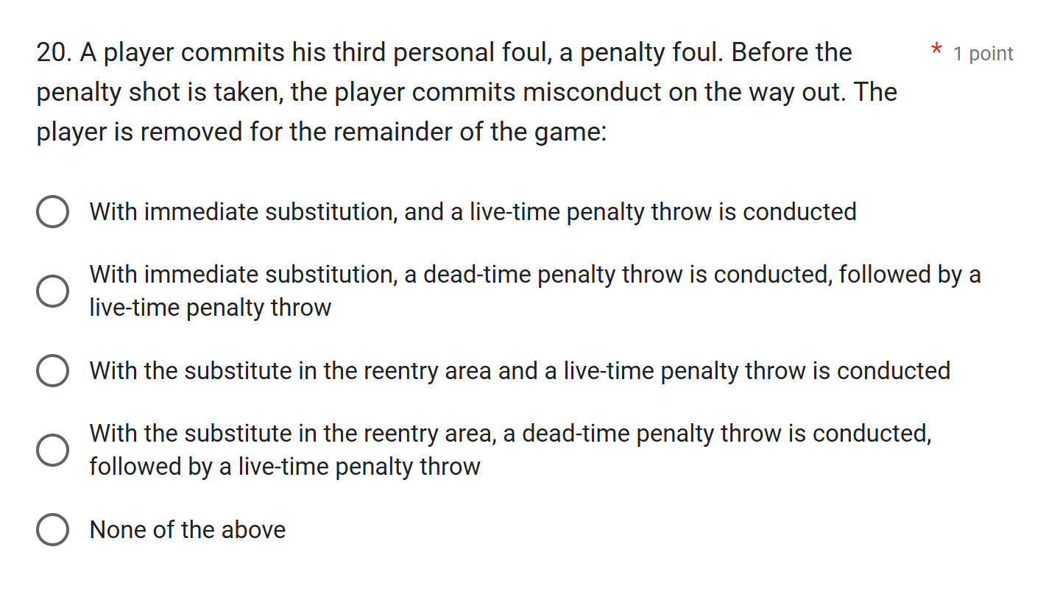
NFHS Rules Test Review
Go through the following questions with the help of your rule book
Many chose the 4th answer.
Remember that the time between a penalty foul and the taking of the penalty throw is considered
“Interval Time”
So there is
“immediate substitution”

Slide 12
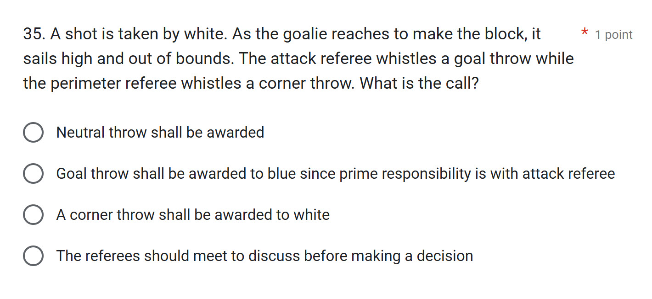
NFHS Rules Test Review
Go through the following questions with the help of your rule book
This is where we should read through:
Instructions for the use of two referees - Appendix B (pages 89-90)
You will find this on:
pg.90 #17

Slide 13
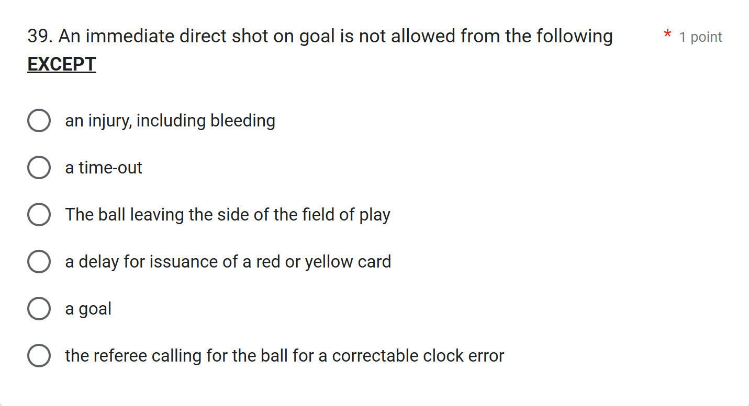
NFHS Rules Test Review
Go through the following questions with the help of your rule book
Remember to fix the rule book pages 46 -47.
(see beginning of this clinic)
The referee calling for the ball for a correctable clock error
(NOTE: highlighted on
page 46)

Slide 14
NFHS Rules Test Review
Any other test questions you would like to discuss?

Slide 15
Important Reminders

Slide 16
Player Safety
Overaggressive play
Fouls, especially with two hands
Advantage
Misconduct may be called for overaggressive or persistent foul play (not playing the ball)
Misconduct vs. Flagrant Misconduct

Slide 17
Referee Collaboration
Referees are a team.
Position
Discussions
Perimeter referee
Double post.

Slide 18
Signalization and Whistle Mechanics
Hand signals and whistles
Make sure the players are aware first before showing the table.
Hand signals should be clear and concise.
Whistles should be loud and crisp.
Standardize your whistles.
Giving signals of what you called.

Slide 19
Solo Officiating
Focused and diligent at all times. Eyes must be moving constantly.
Err on the side of making the call as opposed to no call
Stay mobile
Player safety.
It’s a good idea to make the captains aware during the meeting that you will be on top of the overaggressive play.

Slide 20
Protest Procedure - pg. 32-33 (3-12)
What can protests be filed for?
When must a protest be occur?
Be in control.
Ask the coach what are they protesting?
Discuss with partner and use the rule book.
What happens if the protest is upheld.
Bring both coaches together and explain the decision that was made.
The coach must file a brief written description of the protest after the game. The written protest with the decision must be attached to the scoresheet and signed by the referees.

Slide 21
Shallow Bottom Officiating
6.5 feet or less.
Exclusion Fouls
Offensive Fouls
Penalty Fouls
Goalkeeper
Gaining an advantage.
Players not involved in the play resting on the bottom.

Slide 22
Calling the Game

Slide 23
Calling the Game - Center Position
Away From the Ball:

Slide 24
Calling the Game - Center Position
Ball at the Center Position:

Slide 25
Calling the Game - Perimeter

Slide 26
Calling the Game - Transition

Slide 27
Questions & Answers

